Slide 1
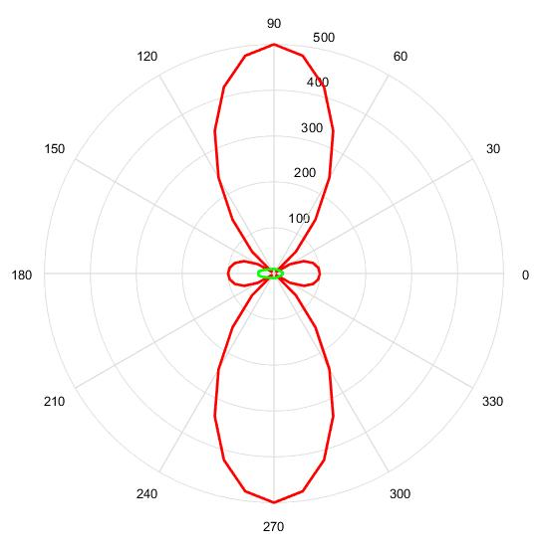
Initial and Desired Pattern

Slide 2
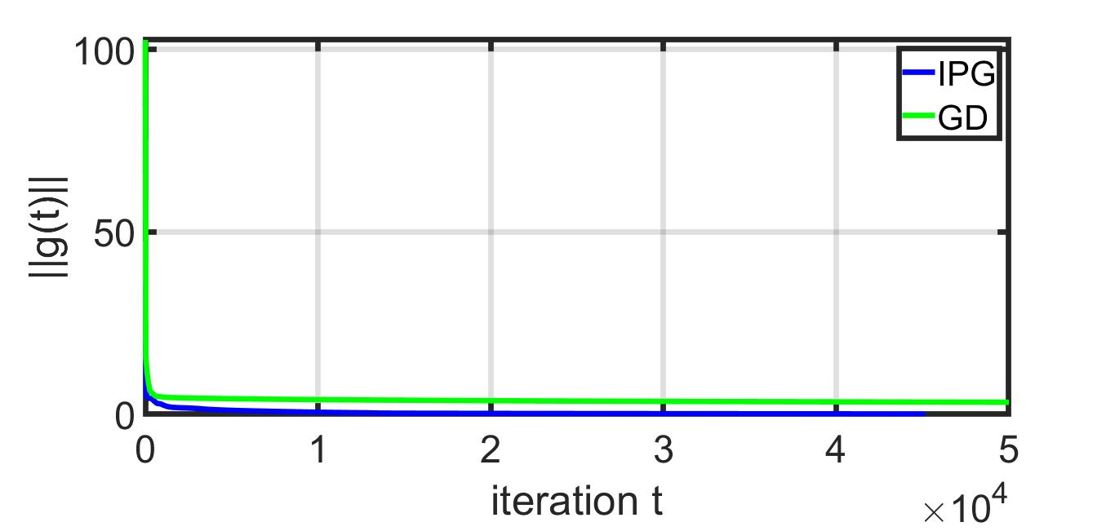
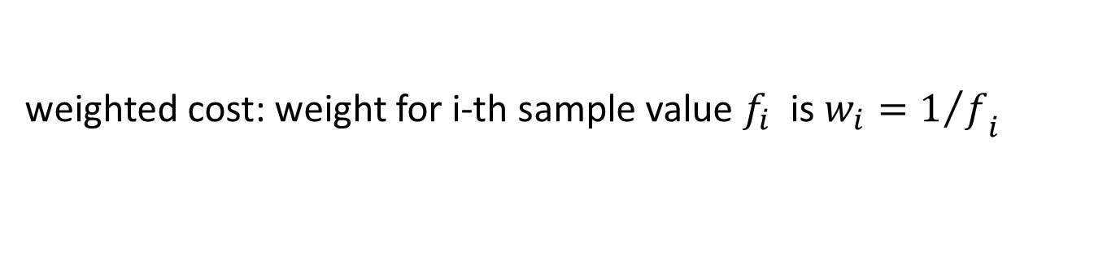
Gradient convergence
weighted cost: weight for i-th sample value $f_{i}$ is ${w_{i}=1/f}_{i}$

Slide 3
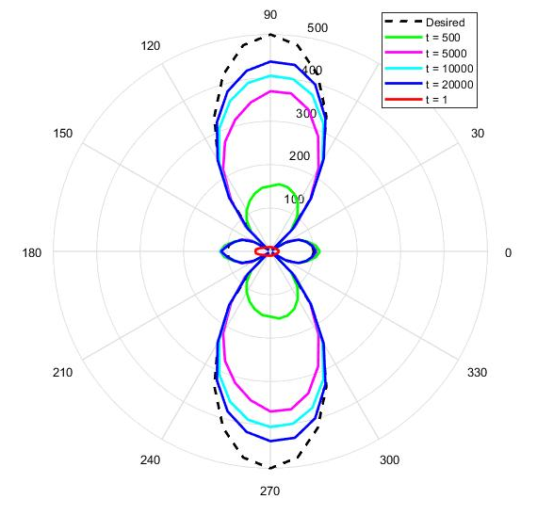
IPG: Pattern
nulls are matched faster due to larger weights
need a better choice of weights

Slide 4
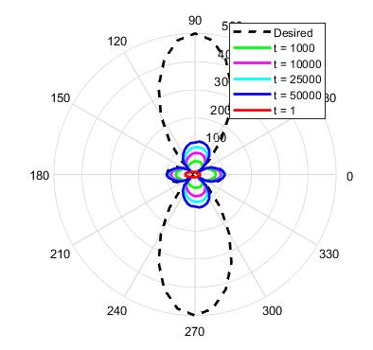
GD: Pattern

